Slide 1
70-357: Developing Mobile App
BRK3257
Mark Rosenberg
MCT, MVP, Other stuff

Slide 2
70-357 : Developing Mobile Apps
Develop a XAML Page Layout for an Adaptive UI
Implement Page Navigation and Lifecycle Events
Implement Data Access and Data Binding
Implement Feature Detection for Adaptive Coding
Manage User Input and Custom User Interactions
Manage Authentication and Identity Management

Slide 3
Resources first
Why?
Big old exam prep list
Just in case we don’t get through everything

Slide 4
Resources

Slide 5
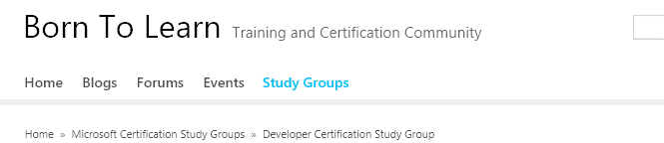
BornToLearn
http://borntolearn.mslearn.net/

Slide 6
MeasureUp
https://mslibrary.measureup.com/
Similar to real testing environment
Take the 70-357 practice test
Also take 70-354 and 70-355 for extra practice
Not same questions, but can highlight where you need more work

Slide 7
70-357 Peering Resources
Do not share questions
Wiki – contribute!- https://aka.ms/70357-study-guide
Email list – http://idweb and join “70537-study”
http://idwebelements/GroupManagement.aspx?Group=70537-study&Operation=join

Slide 8
Resources
Microsoft Virtual Academy- http://microsoftvirtualacademy.com
Ch9 – http://channel9.msdn.com – search uwp
MS Cert Blog - http://borntolearn.mslearn.net
Internal training and cert site – http://traincert
External study guide link – https://www.microsoft.com/en-us/learning/exam-70-357.aspx
Exam vouchers - https://vouchers.cloudapp.net/fte/

Slide 9
Mark’s Test Taking Tips

Slide 10
OneNote Study Guide
Create your own OneNote
One page per study guide section
Outline resources you find
Code an example for EACH section
After exam, immediately sit down and put your thoughts into YOUR OneNote
Share out study guides to shared OneNote, not wiki

Slide 11
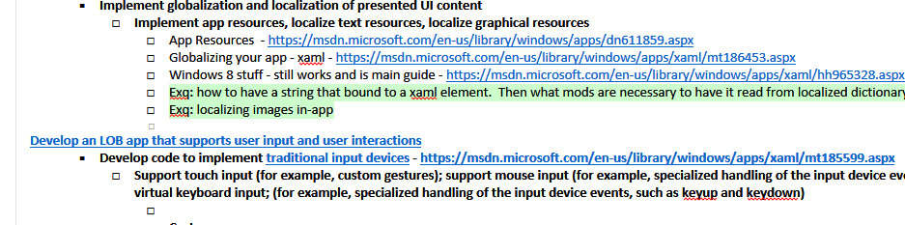
OneNote Study Guide
My 70-354 Study Guide was pretty intense
Lots of notes before taking exam
After exam I went and wrote down what was and wasn’t there
Note I didn’t share it, it was for me

Slide 12
Tricks
No question is trying to TRICK you. Item writers CANNOT do so
Don’t overthink or read-into the question
Eliminate the distractors
Mark items for review
Sections – The test is divided into sections. You CANNOT go back once you have finished a section

Slide 13
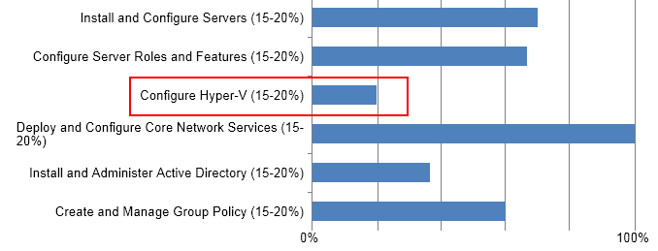
Test Results
If you fail the exam, pay close attention to results
Focus on sections with low scores and revisit study guide

Slide 14
About the Exams

Slide 15
Exam Basics
125 Questions
3 hours to complete exam
Includes all possible questions
Results
700 is passing
Provided Immediately after the exam

Slide 16
Exam Scoring
Each exam has a "cut score"
Each question is worth one point
No partial credit
No points deducted for wrong answers

Slide 17
Be aware as you study
Many examples on the web are for Windows 8.1 apps but will apply to the concepts in this exam.
All the code you see in the exam has to compile. Useful for weeding out distractors
Exams are not adaptive (they don’t get harder or easier based on answers to questions).
Surveys you take at the beginning do not affect the exam

Slide 18
Question Types

Slide 19
How to interpret questions
Business Problem
All questions have a consistent anatomy
Goal Statement
One or Multiple Correct Answers
Questions are not intended to trick you
Multiple Distractors

Slide 20
Build List (BL) Items
Build list items test a candidate’s ability to identify and order the steps/tasks needed to perform a process or procedure
Question Statement
Specify how many tasks the candidate must select and place in the correct order
Instruction Statement
To answer, move the appropriate actions from the list of actions to the answer area and arrange them in the correct order. (not all actions are used)
To answer, move all actions from the list of actions to the answer area and arrange them in the correct order. (all actions are used)
Functionality
Set the “maximum number of choices that can be dragged to the answer area “ to the number of tasks specified in the instruction statement
Answer choices
Minimum = 3; Maximum = 8
Each answer choice can only be used once
Answer Combinations
Up to two are allowed if the number of options remains the same (i.e., there are two possible ways of ordering something) ASSUMING that both combinations can be scored as correct!

Slide 21
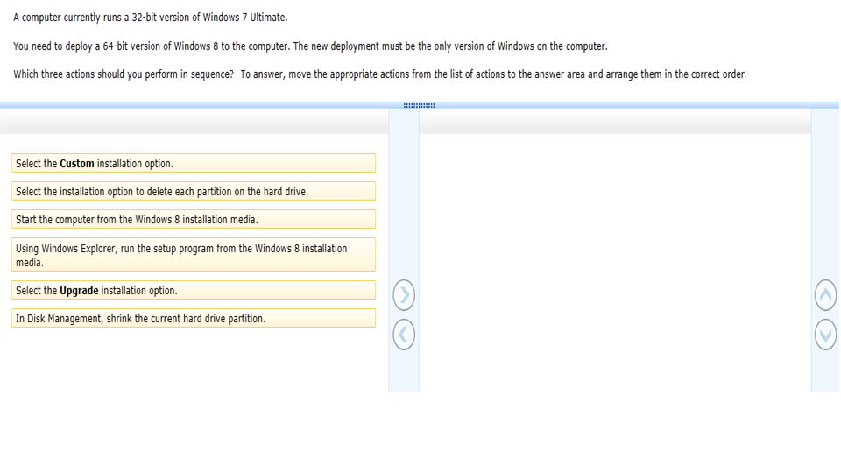
Sample Build List Item

Slide 22
Drag & Drop (DD) Items
Candidates select tasks/objects and drop them into the appropriate place in a graphic. DD items test object placement and anything that can be made more interactive.
Minimum # of answer sources = 3
Sources may be used once, not at all, or more than once
Minimum # of targets = 2
All targets should be filled in the complete solution
Ensure “number of times used” setting matches total number of targets available
Instruction Statement
To answer, drag the appropriate [answer source] to the correct [target or targets]. Each [answer source] may be used once, more than once, or not at all. You may need to drag the split bar between panes or scroll to view content.

Slide 23
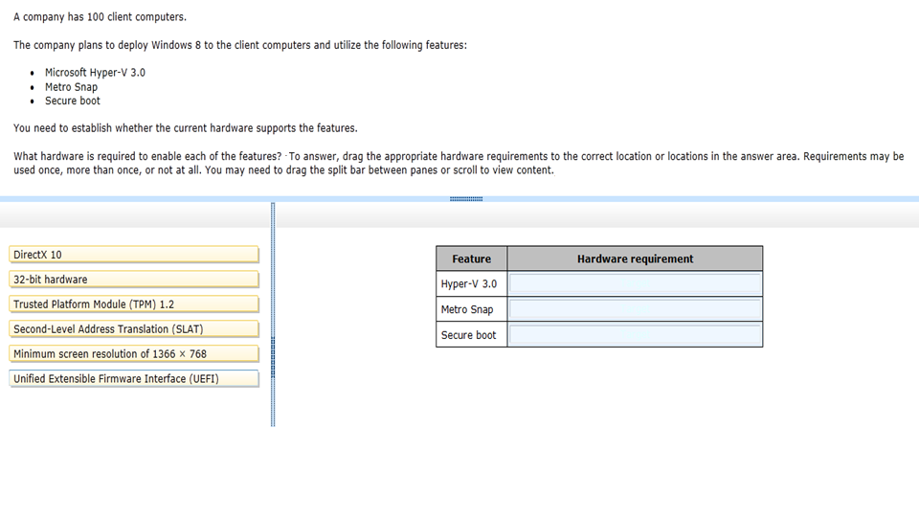
Sample Drag & Drop Item

Slide 24
Active Screen (AS) Items
Candidates answer the item by clicking on “active” areas of an actual screenshot.
A minimum of 3 areas should be “active”
Instruction Statement:
To answer, select the appropriate option in the answer area.
To answer, select the appropriate x in the dialog box in the answer area.

Slide 25
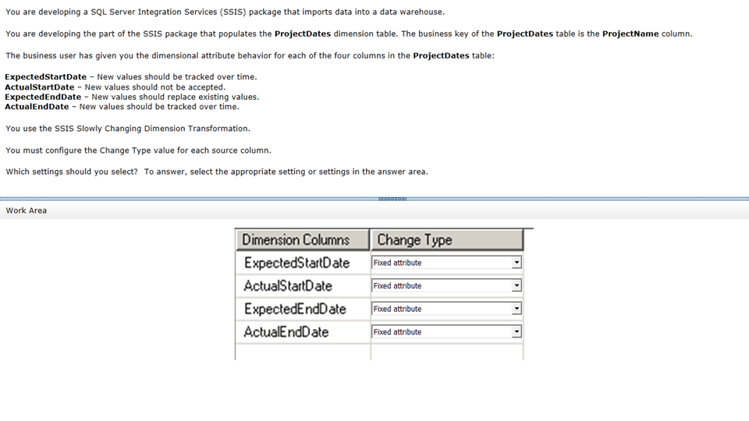
Sample Active Screen Item

Slide 26
Hot Area (HA) Items
Candidates answer the item by clicking on “hot” areas of an exhibit. HA items are essentially multiple choice items with graphical answer choices.
A minimum of 3 areas should be “hot”
Questions can require one or more than one areas that need to be to clicked to be answered correctly.
Avoid testing irrelevant and trivial skills, aka “where should you click”
For example: do not test whether candidate can select the correct tab/window/tool from a graphic
Instruction Statement:
To answer, select the appropriate [object or objects] in the answer area.

Slide 27
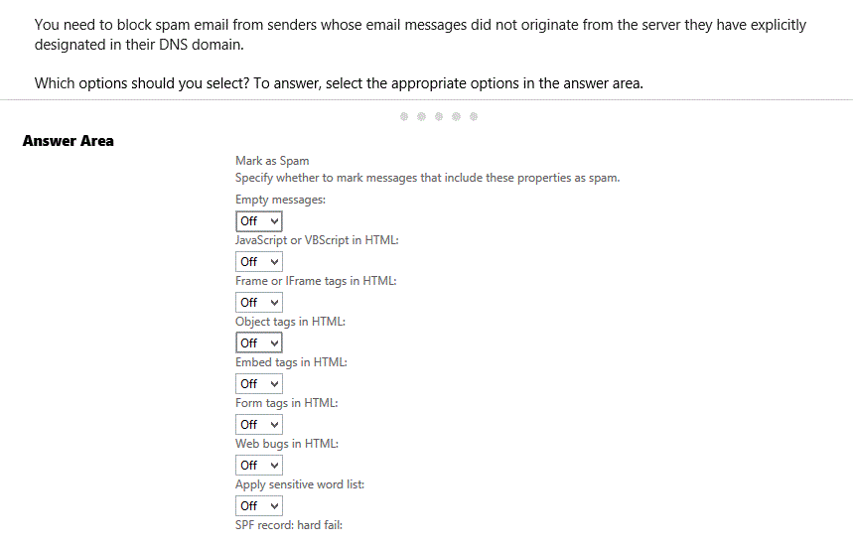
Sample Hot Area Item

Slide 28
Matching (MG) Items
Set up like a Drag and Drop item.
Use to test candidate’s ability to match concepts and terms to the correct definitions and examples
Each target must be filled, but there may be more answer choices than there are targets.
Minimum of 3 targets, maximum of 6 targets
Instruction Statement
Instructions: To answer, drag the appropriate <term> from the column on the left to its <example> on the right. Each <term> may be used once, more than once, or not at all.

Slide 29
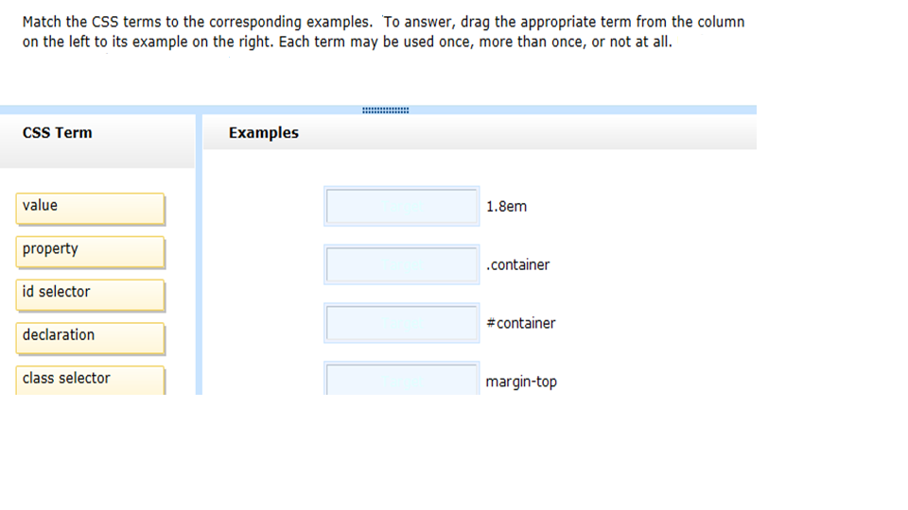
Sample Matching Item

Slide 30
Statement Analysis (SA) Items
Set up as an Active Screen item.
Read the statement and determine if it’s true or false
Ideal to test candidate understanding of key concepts and terms
Each item should contain three Yes/No statements that test the same objective
Instruction Statement
For each of the following statements, select Yes if the statement is true. Otherwise, select No.

Slide 31
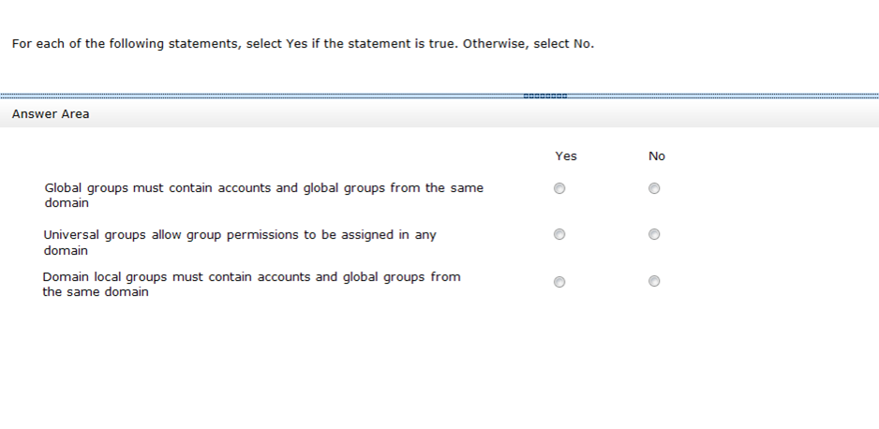
Sample Statement Analysis Item

Slide 32
Sentence Correction (SC) Items
Candidates need to determine whether text that is underlined makes a statement accurate.
Each item should contain one statement
Include “No change is needed.” as an answer choice .
This answer should be in the same option position in each item (first or last).
The following text should appear in boldface at the start of each Sentence Correction item:
This question requires that you evaluate the underlined text to determine if it is correct.
Instruction Statement
Review the underlined text. If it makes the statement correct, select “No change is needed.” If the statement is incorrect, select the answer choice that makes the statement correct.

Slide 33
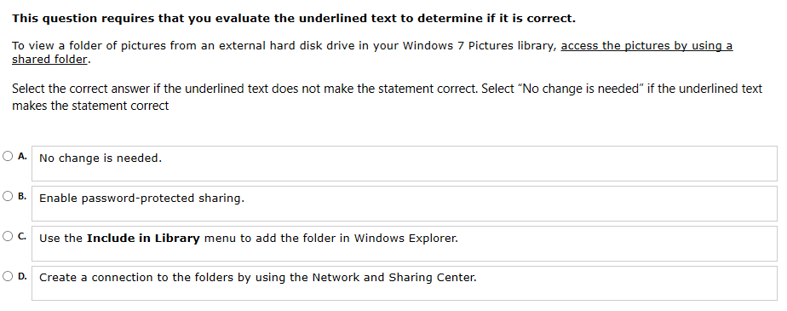
Sample Sentence Correction Items

Slide 34
Two-Part Analysis (PA) Items
Select one answer from each column to solve a problem with a two-part solution. Possible answers should be presented in a table with a column for each part.
Identify what should and should not work/happen/occur
Propose solutions to address complex business requirements
Ideal for planning and design questions
The table must have 2 answer columns and at least 3 rows.
Instruction Statement
Example: In the table below, identify the server role that must be placed in each location to ensure Contoso’s business requirements are supported.
NOTE: Make only one selection in each column.

Slide 35
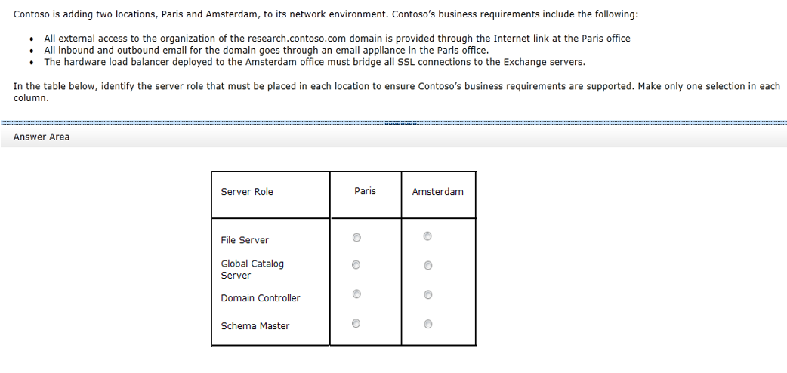
Sample Two-Part Analysis Item

Slide 36
Graphics Interpretation (GI) Items
Interpret the graphical image and select the option from a drop-down list to make the answer statements accurate
Ideal to test candidate ability to analyze environmental data
Identify present behavior and predict future
Each item must contain two drop-down lists
Each drop-down list should contain 3-5 answer choices
Instruction Statement (modify as appropriate)
Use the drop-down menus to select the answer choice that completes each statement based on the information presented in the graphic.

Slide 37
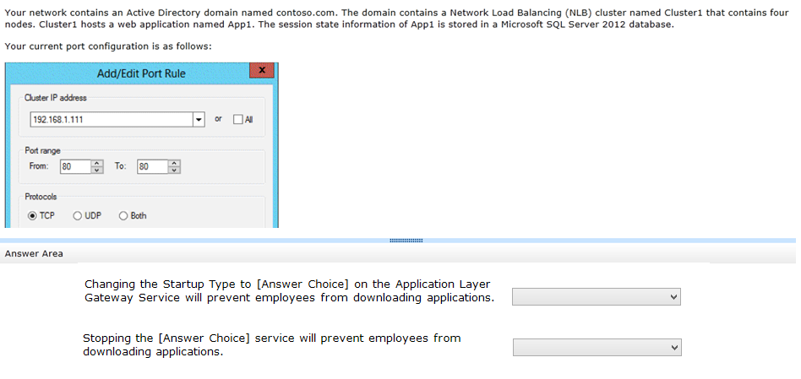
Sample Graphics Interpretation Item

Slide 38
Code (Table) (CA) Analysis Items
Analyze the data to determine whether certain conditions are met.
On developer exams, ideal to test candidate understanding of code functionality
Use this type to test candidate ability to predict end result(s)
Each question will have statements with opposing answers; select one answer for each statement.
Candidate should be asked to evaluate a minimum of 3 statements and a maximum of 4 statements
Yes/No statements are appropriate.
Instruction Statement
Example: For each of the following statements, select Yes if the statement is true. Otherwise, select No.

Slide 39
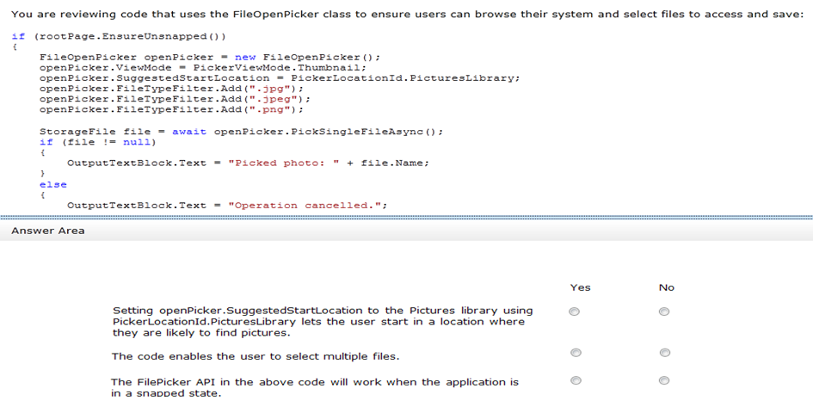
Sample Code Analysis Item

Slide 40
Multi-Source Reasoning/Analysis (MS) Items
Click different data points and discern which data you need to answer the question.
Ideal for troubleshooting questions
Try for planning, design, architecture questions
Each item should require candidate to reference three data points to correctly answer the question
Email/Reports
Screenshots
Exhibits/Graphics/Images
Instruction Statement
Example: Select Yes if the statement can be shown to be true based on the available information. Otherwise, select No.

Slide 41
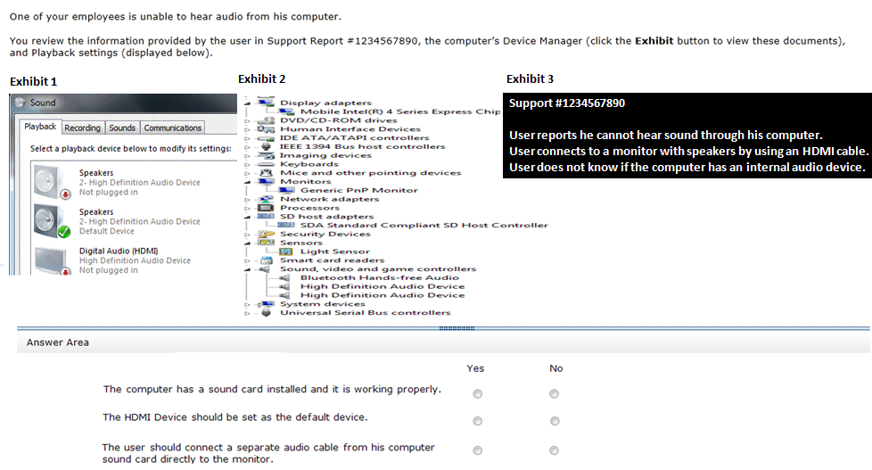
Sample Multi-Source Reasoning Item

Slide 42
Case Study Items
Business case will be presented and several questions will refer to this case.
Multiple question types will be presented
Each question must refer back to the case study materials
Always at least one to two case study tie-backs
Strategy
Possibly skip reading the ENTIRE case study and start with the questions
Know that the question WILL refer to the case study material

Slide 43
Study Guide Review

Slide 44
Review from Here
Easy to layout tips and such
Turns into a UWP Tech Talk
We don’t want that
Let’s talk about what to study in each section
And let’s build up some resources for the exam wiki

Slide 45
What are reference resources
Two definitive sources
BEST – MSDN docs from microsoft.com
GOOD – stackoverflow posts

Slide 46
Develop a XAML page layout for an adaptive UI

Slide 47
Construct a page layout
Configure a RelativePanel layout
select the appropriate XAML layout panel based on the UI requirement
configure a grid with appropriate column and row properties
configure alignment, margins, and padding
{{{ page layout resources on next page }}}

Slide 48
Page Layout Resources
RelativePanel class https://msdn.microsoft.com/en-us/library/windows/apps/windows.ui.xaml.controls.relativepanel.aspx
StackPanel class https://msdn.microsoft.com/en-us/library/windows/apps/windows.ui.xaml.controls.stackpanel.aspx
Grid class https://msdn.microsoft.com/en-us/library/windows/apps/windows.ui.xaml.controls.grid.aspx
Hub class https://msdn.microsoft.com/en-us/library/windows/apps/windows.ui.xaml.controls.hub.aspx

Slide 49
Implement responsive and adaptive UI behaviors
Differentiate between responsive and adaptive UI behaviors, create responsive and adaptive UIs by using VisualStateManager and AdaptiveTriggers, implement settings syntax for element properties and attached properties
Adaptive trigger - https://msdn.microsoft.com/library/windows/apps/windows.ui.xaml.adaptivetrigger.aspx

Slide 50

ZoomIn on AdaptiveTrigger
<VisualStateManager.VisualStateGroups>
<VisualStateGroup>
<VisualState x:Name="Small">
<VisualState.StateTriggers>
<AdaptiveTrigger MinWindowWidth="0" />
</VisualState.StateTriggers>
<VisualState.Setters>
<Setter Target="Button1.Content" Value="Narrow" />
</VisualState.Setters>
</VisualState>
<VisualState x:Name="Big">
<VisualState.StateTriggers>
<AdaptiveTrigger MinWindowWidth="600" />
</VisualState.StateTriggers>
<VisualState.Setters>
<Setter Target="Button1.Content" Value="Wide" />
</VisualState.Setters>
</VisualState>
</VisualStateGroup>
</VisualStateManager.VisualStateGroups>
Reference: https://www.microsoft.com/en-gb/developers/articles/week03aug15/designing-with-adaptive-triggers-for-windows-10/

Slide 51
Create and use custom controls within an adaptive UI
Evaluate when to create a custom control
create a custom control
implement styles, themes, and resource dictionaries
apply styles to custom controls by using Generic.xaml
{{{ styling resources on the next page }}}

Slide 52
Styling Resources
Walkthrough: A Custom Control in XAML isn’t a User Control http://blog.jerrynixon.com/2013/01/walkthrough-custom-control-in-xaml-isnt.html
UserControl Class https://msdn.microsoft.com/en-us/library/system.windows.controls.usercontrol(v=VS.95).aspx
Customizing the Appearance of an Existing Control by Using a ControlTemplate https://msdn.microsoft.com/en-us/subscriptions/index/cc189093(v=vs.95).aspx
Building a custom control using XAML and C# https://blogs.msdn.microsoft.com/windowsappdev/2012/10/15/building-a-custom-control-using-xaml-and-c/
ContentDialog class https://msdn.microsoft.com/en-us/library/windows/apps/windows.ui.xaml.controls.contentdialog.aspx
ResourceDictionary class https://msdn.microsoft.com/en-us/library/windows/apps/windows.ui.xaml.resourcedictionary.aspx
Style class https://msdn.microsoft.com/en-us/library/windows/apps/windows.ui.xaml.style.aspx
{ThemeResource} markup extension https://msdn.microsoft.com/en-us/windows/uwp/xaml-platform/themeresource-markup-extension
{StaticResource} markup extension https://msdn.microsoft.com/en-us/windows/uwp/xaml-platform/staticresource-markup-extension

Slide 53
Optimize a page layout
Reduce complexity for performance gains, reduce unnecessary nesting
Optimize your XAML layout https://msdn.microsoft.com/en-us/windows/uwp/debug-test-perf/optimize-your-xaml-layout
Optimize your XAML markup https://msdn.microsoft.com/en-us/windows/uwp/debug-test-perf/optimize-xaml-loading

Slide 54
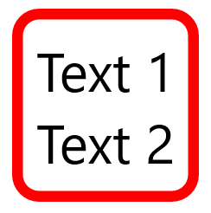
ZoomIn on Optimizing XAML Layout
Bad
<Border BorderBrush="Red" BorderThickness="10" CornerRadius="20" Padding="12">
<StackPanel >
<TextBlock Text="Text 1"/>
<TextBlock Text="Text 2"/>
</StackPanel>
</Border>
Better
<StackPanel BorderBrush="Red" BorderThickness="10" CornerRadius="20" Padding="12">
<TextBlock Text="Text 1"/>
<TextBlock Text="Text 2"/>
</StackPanel>
Reference: https://msdn.microsoft.com/en-us/windows/uwp/debug-test-perf/optimize-your-xaml-layout

Slide 55
Implement page navigation and lifecycle events

Slide 56
Reduce complexity for performance gains, reduce unnecessary nesting
Evaluate when to implement the Hub, Master/Details, Tabs and Pivot, and Nav Pane navigation patterns; evaluate when to implement a custom navigation pattern

Slide 57
Implement Nav Pane navigation
Load page content by using Frame.Navigate, implement page navigation by using the Nav Pane pattern
implement a SplitView control for use as a navigation pane; support accessibility requirements within navigation by implementing key based navigation, UI automation, and narrator
handle Back button behavior for different Windows 10 device families

Slide 58
Navigation Resources
Navigation design basics for UWP apps: https://msdn.microsoft.com/en-us/windows/uwp/layout/navigation-basics
UI basics for Universal Windows Platform (UWP) apps: https://msdn.microsoft.com/en-us/library/windows/apps/dn958432.aspx
Navigation: https://msdn.microsoft.com/en-us/library/windows/apps/mt187344.aspx
Design & UI: https://developer.microsoft.com/en-us/windows/design
Navigation https://msdn.microsoft.com/en-us/library/windows/apps/mt187344.aspx#backnavigation
Back button navigation https://msdn.microsoft.com/en-us/library/windows/apps/mt465734.aspx

Slide 59
Manage app activation
Launch an app, activate an app on Startup, implement activation from a deep link, implement activation based on Search integration, implement activation from a secondary tile
Launching, resuming, and background tasks: https://msdn.microsoft.com/windows/uwp/launch-resume/index
Handle app resume: https://msdn.microsoft.com/windows/uwp/launch-resume/resume-an-app
Handle app suspend: https://msdn.microsoft.com/windows/uwp/launch-resume/suspend-an-app
Optimize suspend/resume: https://msdn.microsoft.com/en-us/windows/uwp/debug-test-perf/optimize-suspend-resume

Slide 60
Manage app suspension and resuming
Prepare an app for suspension, resume from suspension or termination, extend execution and monitor suspension errors
Launching, resuming, and background tasks: https://msdn.microsoft.com/windows/uwp/launch-resume/index
Handle app resume: https://msdn.microsoft.com/windows/uwp/launch-resume/resume-an-app
Handle app suspend: https://msdn.microsoft.com/windows/uwp/launch-resume/suspend-an-app
Optimize suspend/resume: https://msdn.microsoft.com/en-us/windows/uwp/debug-test-perf/optimize-suspend-resume

Slide 61
ZoomIn on Suspend/Resume
Understand Events that are raised
Understand actions performed

Slide 62
ZoomIn on Suspend/Resume
Register and Handle Resume
public MainPage()
{
InitializeComponent();
Application.Current.Resuming += new EventHandler<Object>(App_Resuming);
}
private void App_Resuming(Object sender, Object e)
{
// TODO: Refresh network data
}

Slide 63
ZoomIn on Suspend/Resume
Register and Handle Suspension
partial class MainPage
{
public MainPage()
{
InitializeComponent();
Application.Current.Suspending += new SuspendingEventHandler(App_Suspending);
}
}
async void App_Suspending(
Object sender,
Windows.ApplicationModel.SuspendingEventArgs e)
{
// TODO: This is the time to save app data in case the process is terminated
}

Slide 64
Implement data access and data binding

Slide 65
Access data by using Entity Framework (EF)
Access data by using EFCore with SQLite, implement a local SQLite database
https://docs.efproject.net/en/latest/platforms/uwp/getting-started.html
http://blog.medhat.ca/2015/09/using-sqlite-with-windows-10-uwp.html
https://blogs.windows.com/buildingapps/2016/05/03/data-access-in-universal-windows-platform-uwp-apps/

Slide 66
Binding
Implement the {Binding} Extension
Implement the {x:Bind} extension
Binding Markup - https://msdn.microsoft.com/en-us/windows/uwp/xaml-platform/binding-markup-extension?f=255&MSPPError=-2147217396
x:Bind - https://msdn.microsoft.com/en-us/windows/uwp/xaml-platform/x-bind-markup-extension?f=255&MSPPError=-2147217396
x:Bind markup extensions - https://msdn.microsoft.com/en-us/windows/uwp/xaml-platform/x-bind-markup-extension

Slide 67
ZoomIn on Data Binding
Classic
<Page x:Class="QuizGame.View.HostView" DataContext="{StaticResource ViewModel}" ... >
<Button Content="{Binding Path=NextButtonText, Mode=OneWay}" ... />
</Page>
x:Bind
<Page x:Class="QuizGame.View.HostView" ... >
<Button Content="{x:Bind Path=ViewModel.NextButtonText, Mode=OneWay}" ... />
</Page>
Reference: https://msdn.microsoft.com/en-us/windows/uwp/xaml-platform/x-bind-markup-extension

Slide 68
Implement MVVM classes and class interactions
Implement event binding by applying command patterns, implement a Dispatcher to update the UI thread with async return data
https://blogs.msdn.microsoft.com/johnshews_blog/2015/09/09/a-minimal-mvvm-uwp-app/
https://msdn.microsoft.com/en-us/windows/uwp/data-binding/displaying-data-in-the-designer

Slide 69
ZoomIn on Dispatcher
var dispatcher = CoreApplication.MainView.CoreWindow.Dispatcher;
await dispatcher.RunAsync(CoreDispatcherPriority.Normal, async () =>
{
await signInDialog.ShowAsync();
});
Reference: https://msdn.microsoft.com/en-us/library/windows/apps/windows.ui.core.coredispatcher.runasync.aspx

Slide 70
Implement app-to-app communications
Integrate a Share contract to share content with another app, integrate drag-and-drop, launch an app for results, implement app extensions, implement App Services
A Developer's Guide to Windows 10: (11) App to App Communication: https://channel9.msdn.com/Series/A-Developers-Guide-to-Windows-10/11#time=05m33s
App-to-App communication: https://msdn.microsoft.com/windows/uwp/app-to-app/index
Copy and paste: https://msdn.microsoft.com/en-us/windows/uwp/app-to-app/copy-and-paste
https://msdn.microsoft.com/en-us/windows/uwp/app-to-app/drag-and-drop

Slide 71
Implement REST Web Services
Implement JSON and data serialization, access cloud data and Web APIs by using HttpClient
https://blogs.windows.com/buildingapps/2015/11/23/demystifying-httpclient-apis-in-the-universal-windows-platform/#DKeMAc5D7hGv3G0a.99
https://msdn.microsoft.com/en-us/windows/uwp/networking/httpclient?f=255&MSPPError=-2147217396

Slide 72
Implement file system access
Manage storage by using StorageFile, StorageFolder, and StorageItem
Access a file location by using FilePickers
Implement data roaming and roaming folders
https://msdn.microsoft.com/en-us/windows/uwp/files/quickstart-using-file-and-folder-pickers
StorageFile class - https://msdn.microsoft.com/en-us/library/windows/apps/br227171.aspx

Slide 73
ZoomIn on File Picker
var picker = new Windows.Storage.Pickers.FileOpenPicker();
picker.ViewMode = Windows.Storage.Pickers.PickerViewMode.Thumbnail;
picker.SuggestedStartLocation =
Windows.Storage.Pickers.PickerLocationId.PicturesLibrary;
picker.FileTypeFilter.Add(".png");
Windows.Storage.StorageFile file = await picker.PickSingleFileAsync();
if (file != null)
{
this.textBlock.Text = "Picked photo: " + file.Name;
}
else
{
this.textBlock.Text = "Operation cancelled.";
}
Reference: https://msdn.microsoft.com/en-us/windows/uwp/files/quickstart-using-file-and-folder-pickers

Slide 74
ZoomIn on File Picker
var files = await picker.PickMultipleFilesAsync();
if (files.Count > 0)
{
StringBuilder output = new StringBuilder("Picked files:\n");
foreach (Windows.Storage.StorageFile file in files)
{
output.Append(file.Name + "\n");
}
this.textBlock.Text = output.ToString();
}
else
{
this.textBlock.Text = "Operation cancelled.";
}
Reference: https://msdn.microsoft.com/en-us/windows/uwp/files/quickstart-using-file-and-folder-pickers

Slide 75
Implement feature detection for adaptive coding

Slide 76
Adaptive Code
Implement API detection
Implement Type detection
Dynamically detecting features with API contracts (10 by 10) https://blogs.windows.com/buildingapps/2015/09/15/dynamically-detecting-features-with-api-contracts-10-by-10/
Windows.ApplicationModel.Calls.CallsPhoneContract https://msdn.microsoft.com/en-us/library/windows/apps/dn706142.aspx?f=255&MSPPError=-2147217396
DeviceForm https://msdn.microsoft.com/en-us/library/windows/hardware/mt168514(v=vs.85).aspx
https://msdn.microsoft.com/en-us/library/windows/apps/dn949016.aspx
https://msdn.microsoft.com/en-us/library/windows/apps/windows.foundation.metadata.apiinformation.isapicontractpresent.aspx

Slide 77
Implement supported capabilities
Implement support for a microphone, implement support for a webcam, implement support for location, implement support for enterprise authentication
https://msdn.microsoft.com/en-us/windows/uwp/packaging/app-capability-declarations
https://msdn.microsoft.com/en-us/windows/uwp/audio-video-camera/capture-photos-and-video-with-mediacapture?f=255&MSPPError=-2147217396
https://msdn.microsoft.com/en-us/windows/uwp/packaging/app-capability-declarations?f=255&MSPPError=-2147217396
https://msdn.microsoft.com/en-ca/library/windows/apps/mt219698.aspx

Slide 78
Manage user input and custom user interactions

Slide 79
Implement command bars, flyouts, and dialogs
Implement command bars and AppBarButton buttons, implement context menus and menu flyouts, implement content dialogs, display a tooltip by using ToolTipService, display a pop-up menu, implement control over app settings
App bar and command bar https://msdn.microsoft.com/windows/uwp/controls-and-patterns/app-bars
CommandBar class https://msdn.microsoft.com/en-us/library/windows/apps/windows.ui.xaml.controls.commandbar.aspx
AppBar class https://msdn.microsoft.com/windows/uwp/controls-and-patterns/app-bars
ToolTip class https://msdn.microsoft.com/en-us/library/windows/apps/windows.ui.xaml.controls.tooltip.aspx

Slide 80
Input devices
Support touch input, support mouse input, support keyboard and virtual keyboard input
Input & devices: https://developer.microsoft.com/en-us/windows/design/inputs-devices
Mouse interactions: https://msdn.microsoft.com/windows/uwp/input-and-devices/mouse-interactions
Touch interactions: https://msdn.microsoft.com/en-us/windows/uwp/input-and-devices/touch-interactions
Touch design guidelines: https://msdn.microsoft.com/en-us/windows/uwp/input-and-devices/guidelines-for-user-interaction
Handle pointer input: https://msdn.microsoft.com/en-us/windows/uwp/input-and-devices/handle-pointer-input
Touch: https://msdn.microsoft.com/en-us/library/windows/desktop/dn742468(v=vs.85).aspx

Slide 81
Implement speech and voice commands
Support speech synthesis, support speech recognition, support Cortana integration, support Personal Assistant Launch capability, support voice commands
{{{ resources on next page }}}

Slide 82
Speech Resources
Cortana interactions in UWP apps: https://msdn.microsoft.com/en-us/windows/uwp/input-and-devices/cortana-interactions
Activate a foreground app with voice commands through Cortana: https://msdn.microsoft.com/en-us/windows/uwp/input-and-devices/launch-a-foreground-app-with-voice-commands-in-cortana
Voice Command Definition (VCD) elements and attributes v1.2: https://msdn.microsoft.com/library/windows/apps/dn706593
Speech interactions: https://msdn.microsoft.com/windows/uwp/input-and-devices/speech-interactions
SpeechSynthesizer class: https://msdn.microsoft.com/en-us/library/windows.media.speechsynthesis.speechsynthesizer.aspx
Speech recognition and synthesis sample: https://github.com/Microsoft/Windows-universal-samples/tree/master/Samples/SpeechRecognitionAndSynthesis

Slide 83
Implement alternative forms of input
Implement inking, implement camera input, implement location services and GPS input
Get the user's location: https://msdn.microsoft.com/en-us/library/windows/apps/mt219698.aspx
Guidelines for location-aware apps: https://msdn.microsoft.com/en-us/windows/uwp/maps-and-location/guidelines-and-checklist-for-detecting-location
Map APIs and controls: Location services: https://blogs.windows.com/buildingapps/2016/04/07/map-apis-and-controls-location-services/

Slide 84
ZoomIn on GeoLocator
Understand key classes
Understand sequencing

Slide 85
ZoomIn on Geolocator
Geolocator Class
Provides current geolocation
RequestAccessAsync – prompts for permission
GetPositionAsync
LocationStatus – able to provide info
Requires ID_CAP_LOCATION on mobile

Slide 86
ZoomIn on GeoLocator
Request Access
using Windows.Devices.Geolocation;
...
var accessStatus = await Geolocator.RequestAccessAsync();
Prompts users for permission to access their location

Slide 87
ZoomIn on GeoLocator
Get Location, Register for Changes
var accessStatus = await Geolocator.RequestAccessAsync();
switch (accessStatus)
{
case GeolocationAccessStatus.Allowed:
// Create Geolocator and define perodic-based tracking (2 second interval).
_geolocator = new Geolocator { ReportInterval = 2000 };
// Subscribe to the PositionChanged event to get location updates.
_geolocator.PositionChanged += OnPositionChanged;
// Subscribe to StatusChanged event to get updates of location status changes.
_geolocator.StatusChanged += OnStatusChanged;
break;
case GeolocationAccessStatus.Denied:
case GeolocationAccessStatus.Unspecified:
}

Slide 88
ZoomIn on GeoLocator
Handle Location Changes
using Windows.UI.Core;
...
async private void OnPositionChanged(Geolocator sender, PositionChangedEventArgs e)
{
await Dispatcher.RunAsync(CoreDispatcherPriority.Normal, () =>
{
_rootPage.NotifyUser("Location updated.", NotifyType.StatusMessage);
UpdateLocationData(e.Position);
});
}

Slide 89
Manage authentication and identity management

Slide 90
Authentication
Implement web service authentication, implement OAuth, implement Azure Active Directory authentication
Manage credentials securely with Credential Locker
https://msdn.microsoft.com/en-us/windows/uwp/security/web-authentication-broker
https://msdn.microsoft.com/en-us/library/windows.security.authentication.web.webauthenticationbroker.getcurrentapplicationcallbackuri.aspx
https://msdn.microsoft.com/en-us/windows/uwp/security/intro-to-secure-windows-app-development#2-2-1-azure-active-directory
https://msdn.microsoft.com/en-us/windows/uwp/security/credential-locker

Slide 91
ZoomIn on Credential Locker
Understand "how to use" Understand "steps to provision"
App calls the Credential Locker API to store and retrieve the credentials from apps storage container
Managed by the operating system Access is limited to the app that stores them

Slide 92
ZoomIn on Credential Locker
Key Classes
PasswordVault - Gets a reference to the credential locker
PasswordCredential - Created by password vault - uses Windows app and the username and password - passed to password vault

Slide 93
ZoomIn on CredentialLocker
Sample
var vault = new PasswordVault();
vault.Add(new PasswordCredential("My App", username, password));
Reference: https://msdn.microsoft.com/en-us/windows/uwp/security/credential-locker

Slide 94
ZoomIn on CredentialLocker
Request all credentials
string resourceName =“myApp”;
PasswordCredential credential = null;
var vault = new PasswordVault();
var credentialList = vault.FindAllByResource(resourceName);
defaultUserName = GetDefaultUserNameUI();
credential = vault.Retrieve(resourceName, defaultUserName);
Reference: https://msdn.microsoft.com/en-us/windows/uwp/security/credential-locker

Slide 95
Implement two-factor authentication
Implement two-factor authentication using Microsoft Passport, implement two-factor authentication using Windows Hello
Convenient two-factor authentication with Microsoft Passport and Windows Hello: https://blogs.windows.com/buildingapps/2016/01/26/convenient-two-factor-authentication-with-microsoft-passport-and-windows-hello/
Create more secure apps with less effort (10 by 10): https://blogs.windows.com/buildingapps/2015/10/13/create-more-secure-apps-with-less-effort-10-by-10/
KeyCredential class: https://msdn.microsoft.com/en-us/library/windows/apps/windows.security.credentials.keycredential.aspx
Microsoft Passport guide: https://technet.microsoft.com/itpro/windows/keep-secure/microsoft-passport-guide

Slide 96
Implement notifications, background tasks, and reusable components

Slide 97
Create and consume class libraries and Windows Runtime components
Develop Windows Runtime components, develop class libraries, integrate class libraries and Windows Runtime components
https://msdn.microsoft.com/en-us/windows/uwp/winrt-components/creating-windows-runtime-components-in-csharp-and-visual-basic

Slide 98
Implement tile and toast notifications
Implement adaptive and interactive toast notifications, implement local tile notifications
Adaptive and interactive toast notifications: https://msdn.microsoft.com/en-us/windows/uwp/controls-and-patterns/tiles-and-notifications-adaptive-interactive-toasts
Adaptive and interactive toast notifications for Windows 10: https://blogs.msdn.microsoft.com/tiles_and_toasts/2015/07/02/adaptive-and-interactive-toast-notifications-for-windows-10/
Quickstart: Sending a local toast notification and handling activations from it (Windows 10): https://blogs.msdn.microsoft.com/tiles_and_toasts/2015/07/08/quickstart-sending-a-local-toast-notification-and-handling-activations-from-it-windows-10/
Tiles, badges, and notifications for UWP apps: https://msdn.microsoft.com/en-us/windows/uwp/controls-and-patterns/tiles-badges-notifications
Engaging customers with Live Tiles and toast notifications (10 by 10): https://blogs.windows.com/buildingapps/2015/08/18/engaging-customers-with-live-tiles-and-toast-notifications-10-by-10/

Slide 99
Create and register a background task
Create a background task project and reference the background task within a project, implement background task event triggers and conditions
Run a background task on a timer: https://msdn.microsoft.com/en-us/windows/uwp/launch-resume/run-a-background-task-on-a-timer
Register a background task: https://msdn.microsoft.com/en-us/windows/uwp/launch-resume/register-a-background-task
Support your app with background tasks: https://msdn.microsoft.com/en-us/windows/uwp/launch-resume/support-your-app-with-background-tasks
Background task sample: https://github.com/Microsoft/Windows-universal-samples/tree/master/Samples/BackgroundTask

Slide 100
Implement and manage a background task
Monitor background task progress and completion, manage task lifecycle, share data and events between an app and its background tasks, call a background task directly
Declare background tasks in the application manifest: https://msdn.microsoft.com/en-us/windows/uwp/launch-resume/declare-background-tasks-in-the-application-manifest
Run a background task on a timer: https://msdn.microsoft.com/en-us/windows/uwp/launch-resume/run-a-background-task-on-a-timer
Register a background task: https://msdn.microsoft.com/en-us/windows/uwp/launch-resume/register-a-background-task
Support your app with background tasks: https://msdn.microsoft.com/en-us/windows/uwp/launch-resume/support-your-app-with-background-tasks
Background task sample: https://github.com/Microsoft/Windows-universal-samples/tree/master/Samples/BackgroundTask

Slide 101
Create and consume a Universal Windows Platform (UWP) app service
Specify the AppService extension, implement app service as a background task, deploy the app service provider, call app services
Create and consume an app service https://msdn.microsoft.com/en-us/windows/uwp/launch-resume/how-to-create-and-consume-an-app-service
UWP Extensions - https://msdn.microsoft.com/en-us/library/windows/apps/dn934749.aspx
UWP Device Capabilities - https://msdn.microsoft.com/en-us/library/windows/apps/dn263092.aspx

Slide 102
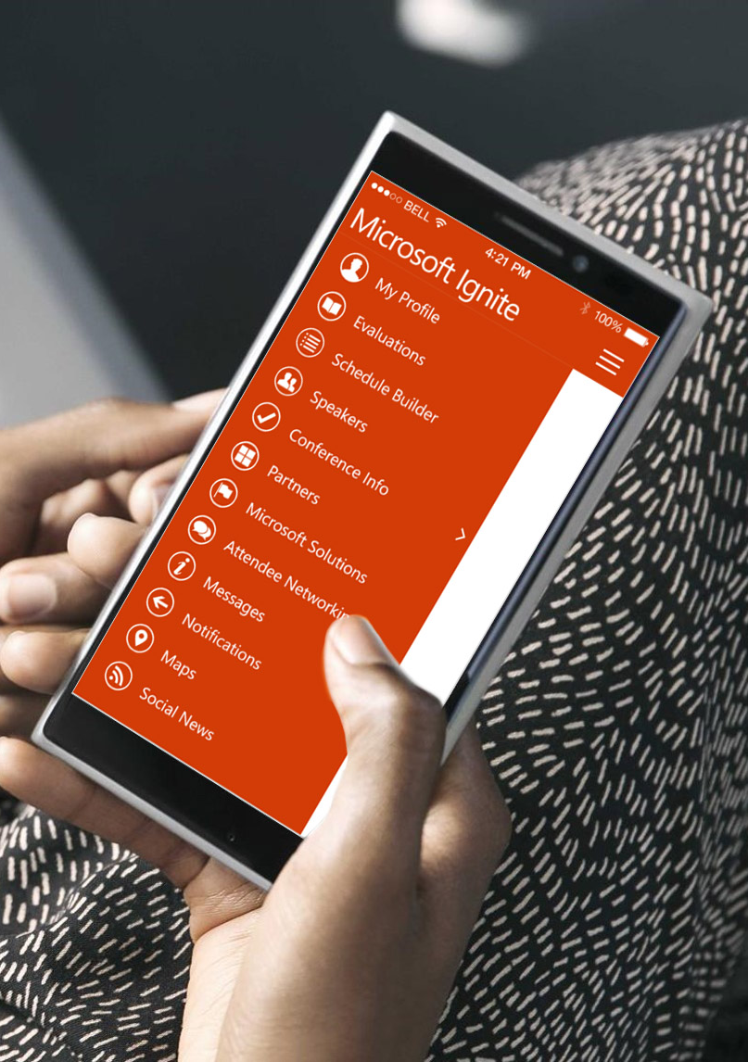
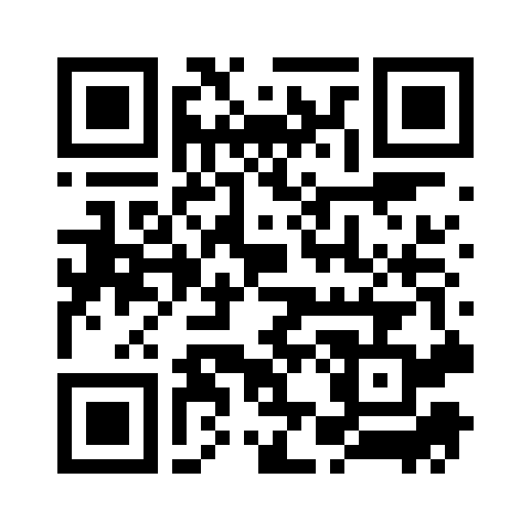
Please evaluate this session
Your feedback is important to us!
From your PC or Tablet visit MyIgnite at http://myignite.microsoft.com
From your phone download and use the Ignite Mobile App by scanning the QR code above or visiting https://aka.ms/ignite.mobileapp

